Slide 1
Stockade 201 Using the Resources
Personal Achievement
Modules
Leader’s Guides
Trail Guides
Outpost Adventures

Slide 2
Stockade 201 Using the Resources
"Stockade Modules, LG's, Outpost Adventures, Achievement, Trail Guides, Patches? How do I use them?" Join us for practical ways to use the new Stockade resources to build your boys, leaders, families, and congregations.

Slide 3
Stockade 201 Using the Resources

Slide 4
BIBLICAL TRUTH
ACTION
wrapped in

Slide 5
BIBLICAL TRUTH
ACTION
wrapped in

Slide 6
Stockade Module
Leader’s Guide
Outpost Adventure

Slide 7
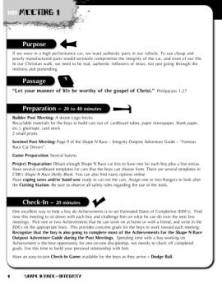
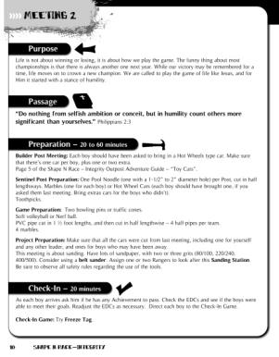
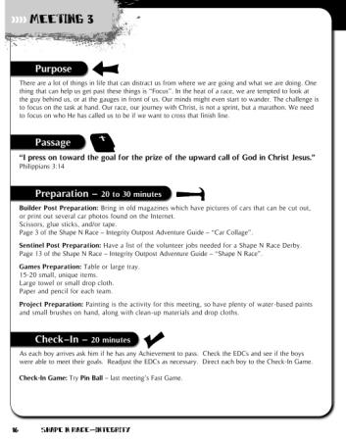
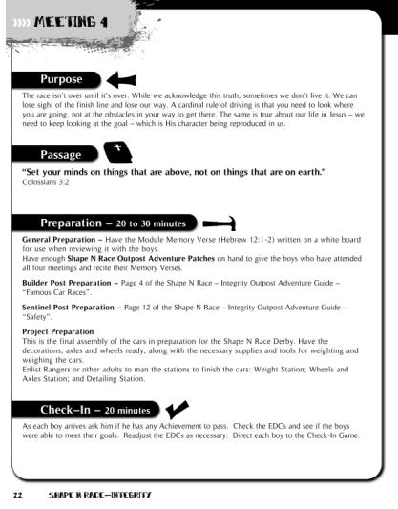
Stockade Module – 4 Meetings
Leader’s Guide

Slide 8
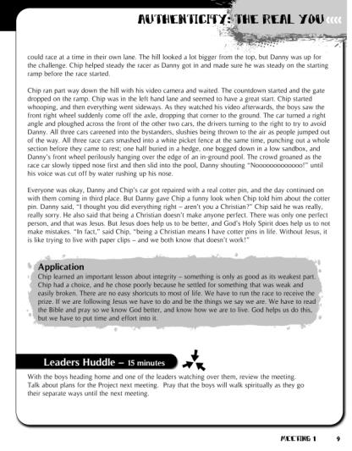
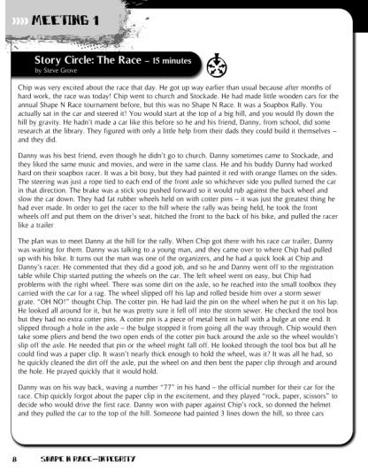
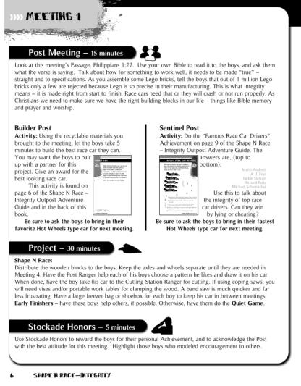
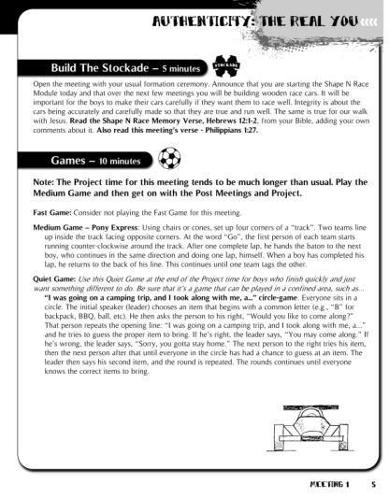
Stockade Module – 4 Meetings
Leader’s Guide

Slide 9
Stockade Module – 4 Meetings
Leader’s Guide
Story Circle
Post Meeting
Build the Stockade
Purpose
Games
Passage
Leaders Huddle
Preparation
Project
Stockade Honors
Check-In

Slide 10
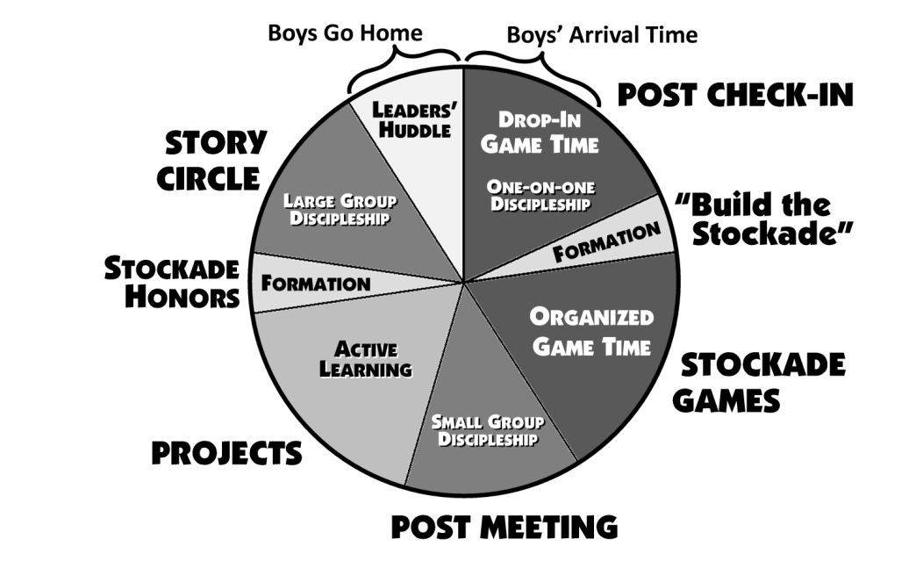
Use the segments of the Leader’s Guide to balance YOUR meeting.

Slide 11
Stockade Module
Leader’s Guide
Outpost Adventure

Slide 12
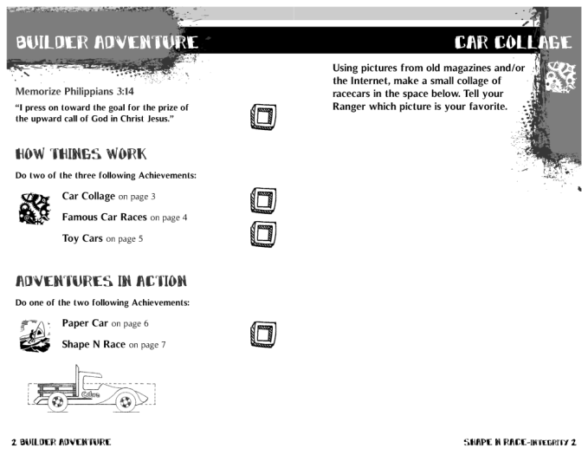
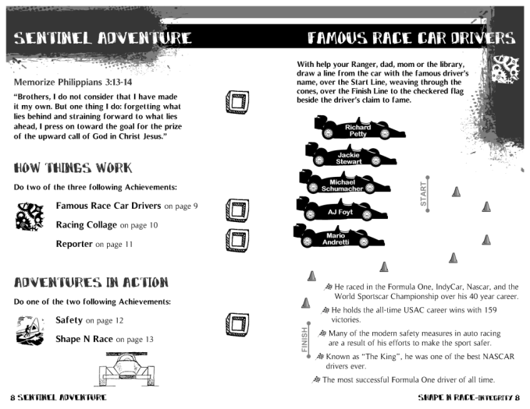
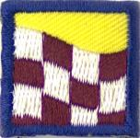
Using Outpost Adventures
4 Achievements – 6 or 7 to choose from.
Memory Verse
How Things Work
Memory Verse
Outpost Adventure
How Things Work
Adventures in Action
Adventures in Action

Slide 13
Using Outpost Adventures
Outpost Adventure
Adventure Patch

Slide 14
Stockade Module
Leader’s Guide
Outpost Adventure

Slide 15
Outpost Adventure in Action

Slide 16
TONIGHT’S THEME: SPIRITUAL CAUTION – Safety First ⁸ Stay alert! Watch out for your great enemy, the devil. He prowls around like a roaring lion, looking for someone to devour. 1 Peter 5:8
TONIGHT’S THEME: THE RIGHT TOOLS =
I have stored up Your Word in my heart,… that I might not sin against You. Psalm 119:11
TONIGHT’S THEME: Measure Twice – Cut Once (Saws) = If we confess our sins, …He is faithful and just…to forgive us our sins… and to cleanse us from all unrighteousness. 1 John 1:9
Outpost Adventure in Action

Slide 17
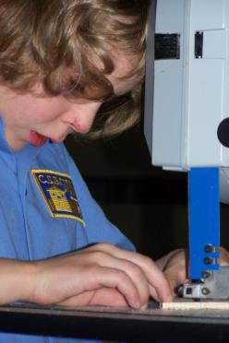
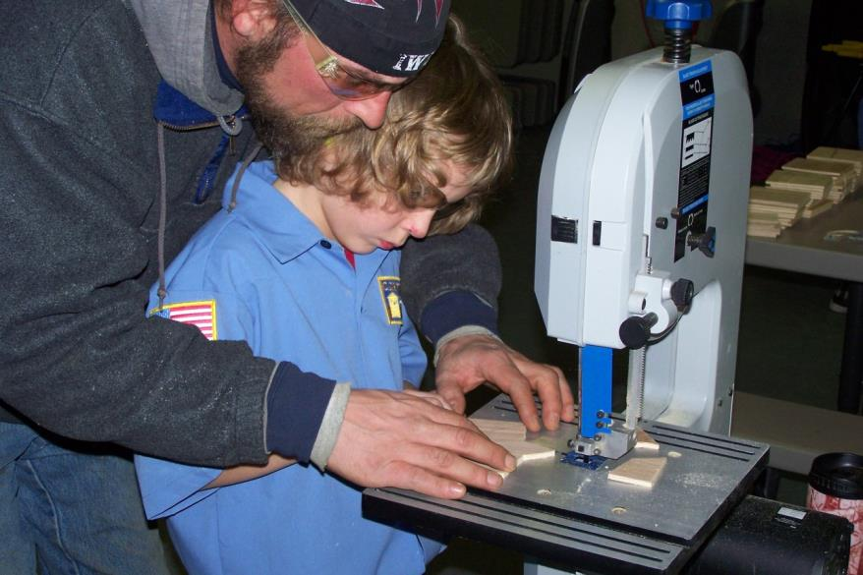
Outpost Adventure in Action

Slide 18
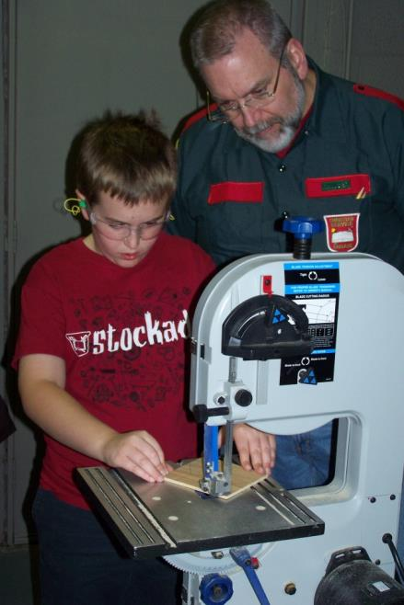
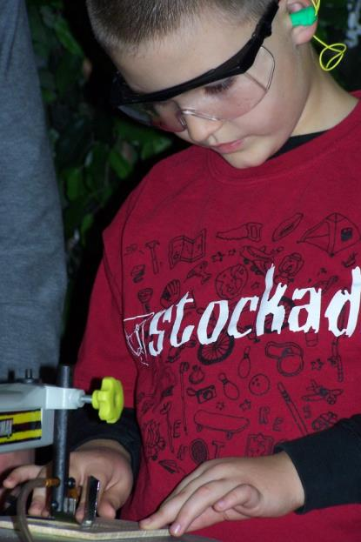
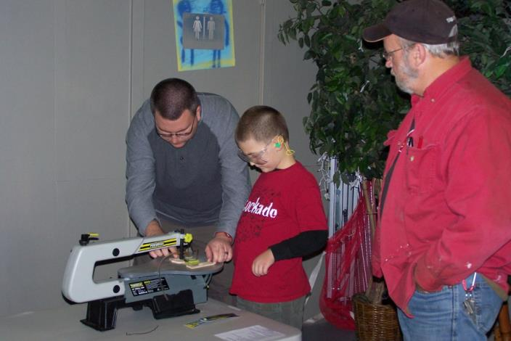
Outpost Adventure in Action

Slide 19
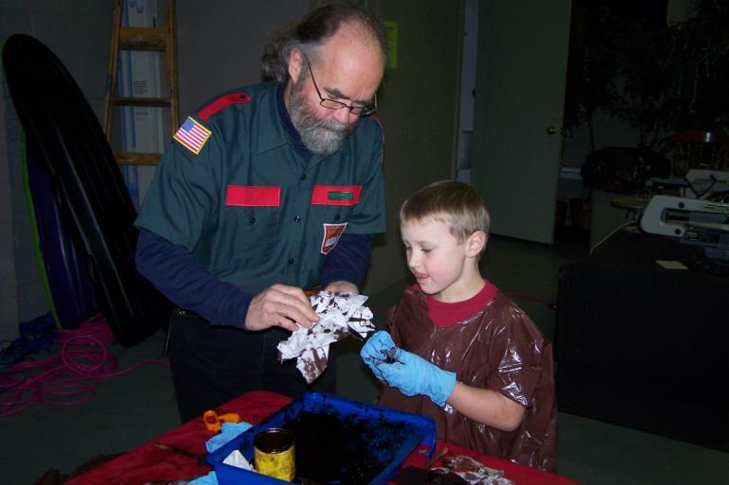
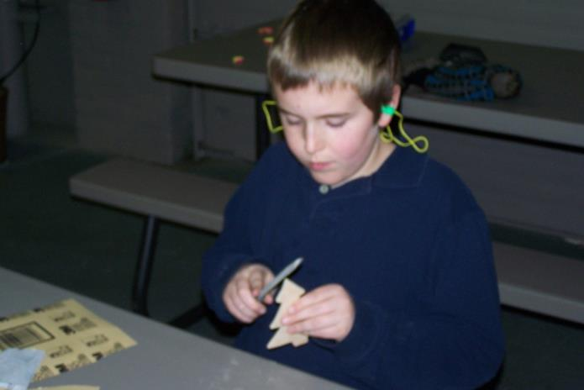
Outpost Adventure in Action

Slide 20
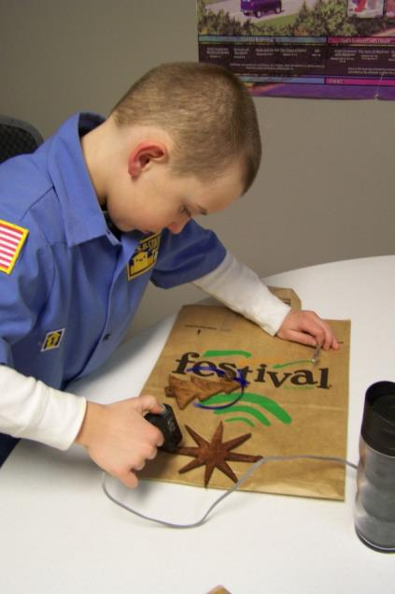
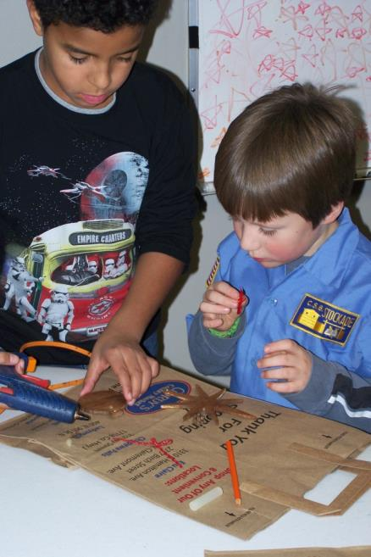
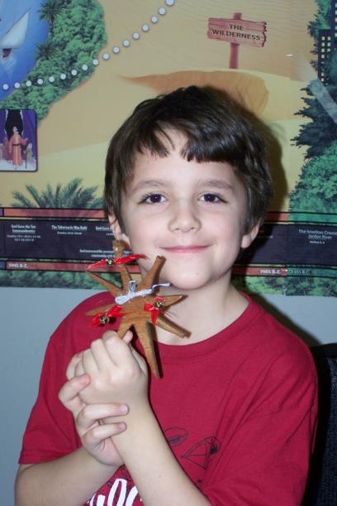
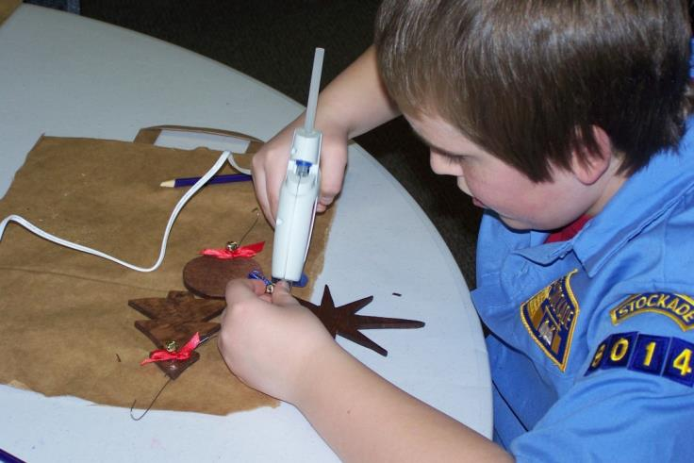
Outpost Adventure in Action

Slide 21
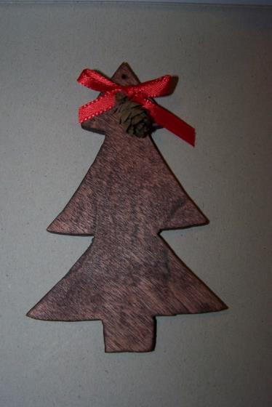

Slide 22
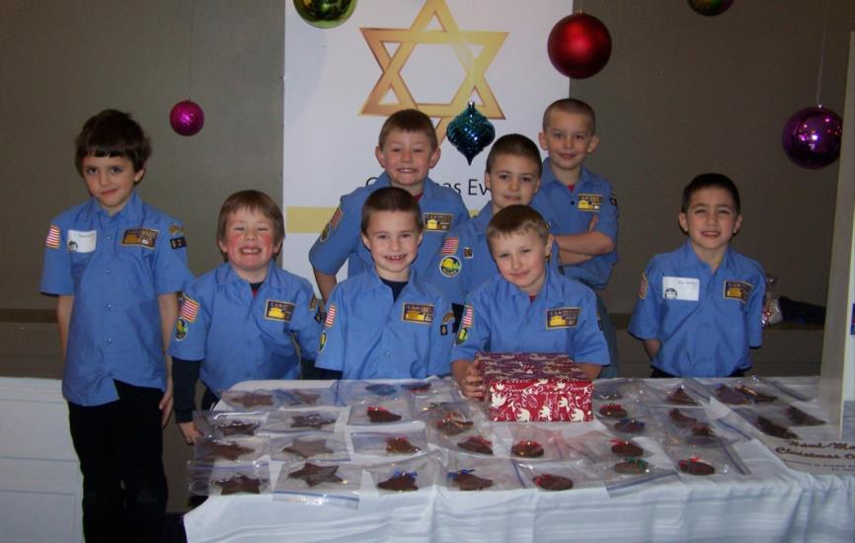
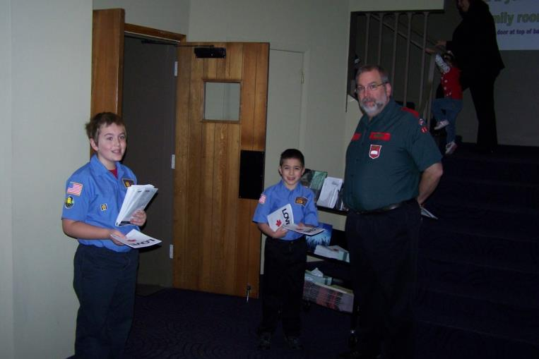
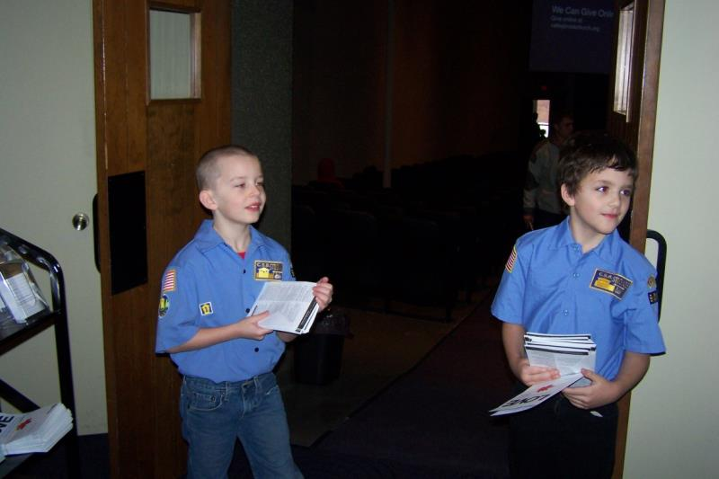
Outpost Adventure in Action

Slide 23
Personal Achievement
Trail Guides
Outpost Adventure

Slide 24
Personal Achievement
… is all about
building a wholesome,
personal friendship between
a Christ-centered man
and a boy.

Slide 25
Personal Achievement
Trail Guides
Outpost Adventure

Slide 26
Personal Achievement
Trail Guides
4 age-related Guides
- One for each year.
2 for Builders
2 for Sentinels

Slide 27
Personal Achievement
Trail Guides
4 age-related Guides
- One for each year.
4 Blockhouses
each
4 Stations
each

Slide 28
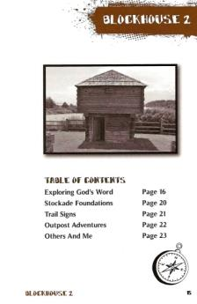
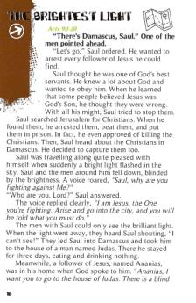
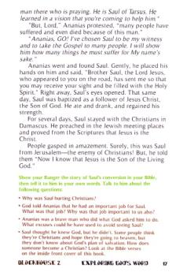
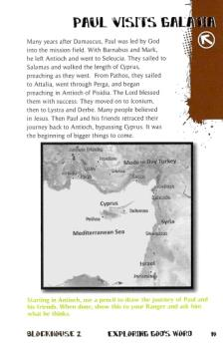
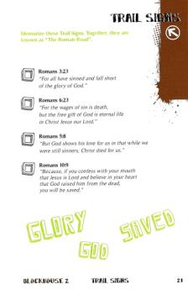
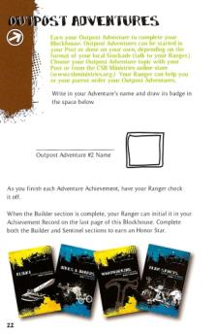
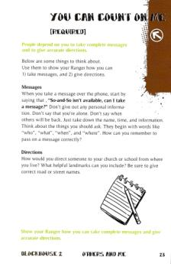
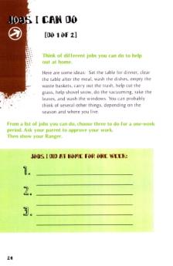
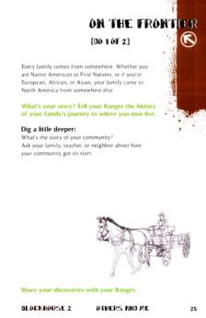
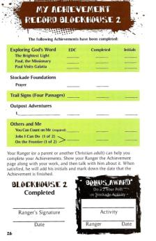
Personal Achievement
Table of Contents
Trail Guides
Exploring God’s Word
Bible Story Bible Study & Activity
NO OPTIONS
4 age-related Guides
- One for each year.
Stockade Foundations
A talk
NO OPTIONS
Trail Signs
A talk
NO OPTIONS
Outpost Adventures
LOTS OF
OPTIONS
Others and Me
SOME REQUIRED & SOME OPTIONS
Achievement Record

Slide 29
Personal Achievement
15 to 25 Achievements per Blockhouse or Station…
WHY?
Because he learns about his world, himself, his God and his Ranger.
And, it involves his family.
Trail Guides

Slide 30
Personal Achievement
?
?
Outpost Adventures
Outpost Adventures
Outpost Adventures
Choose your own Adventure
=
?
?
?
?
?
?
?
?
?
?
?
?

Slide 31
Personal Achievement
Honor Star
Outpost Adventures

Slide 32
Personal Achievement
Trail Guides
Outpost Adventures

Slide 33
Personal Achievement
Can be up to boy and parents.
Can be done in meetings
Motivated by Rangers
Depends on his motivation

Slide 34
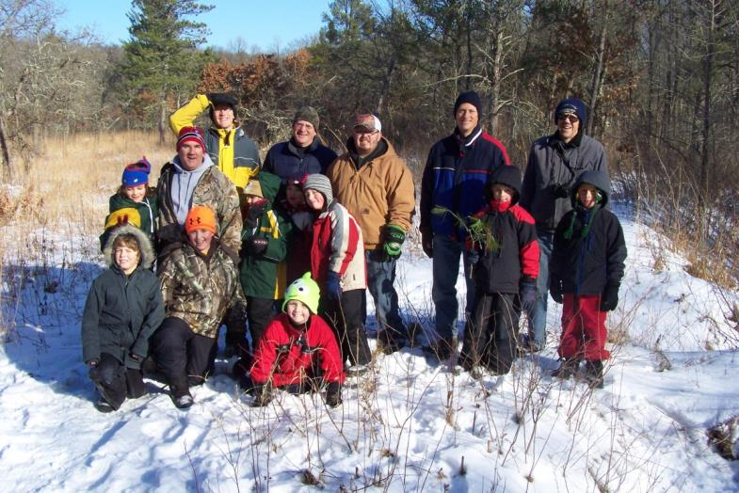
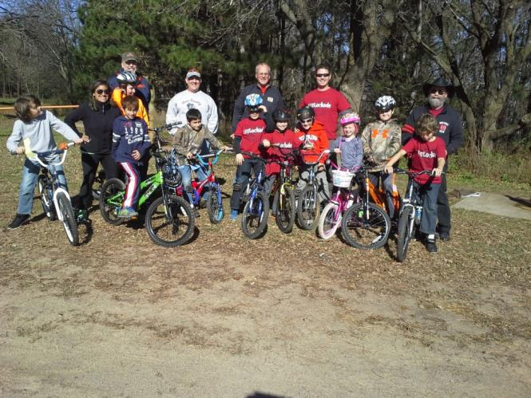
Father/Son
Ranger/Stockader
Family Events
Bonding

Slide 35
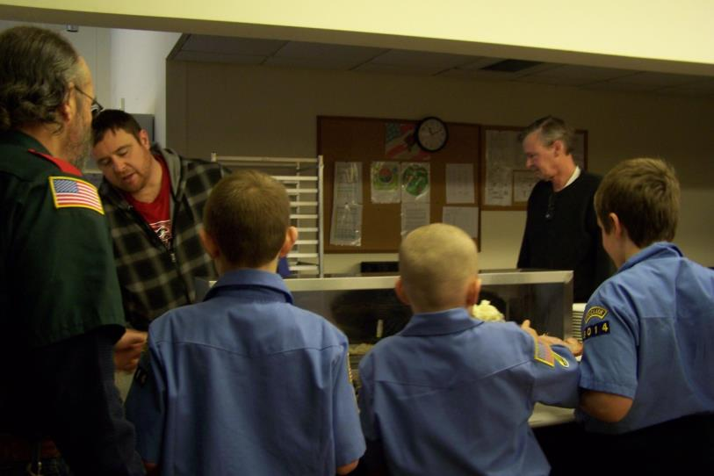
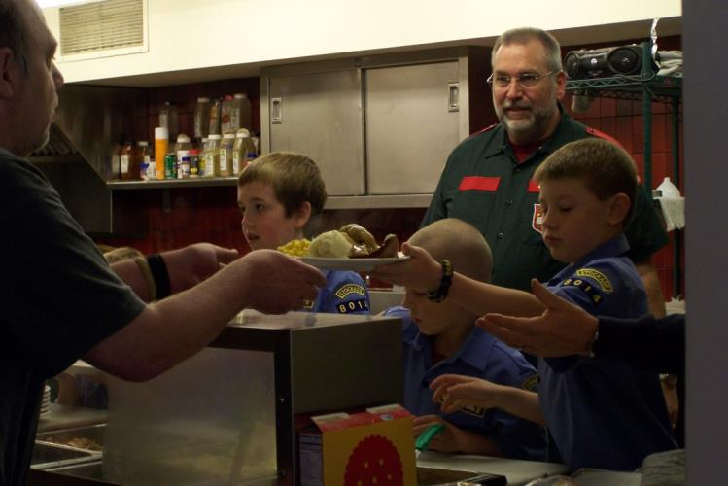
SERVICE
Events
OUTREACH

Slide 36
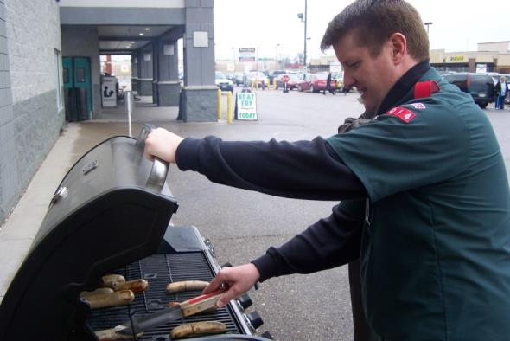
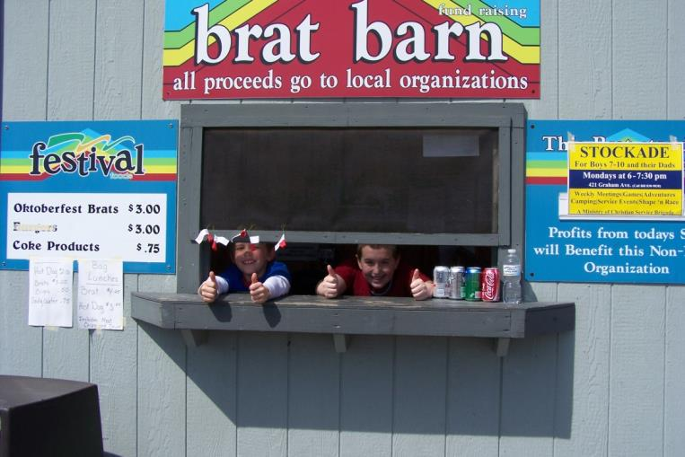
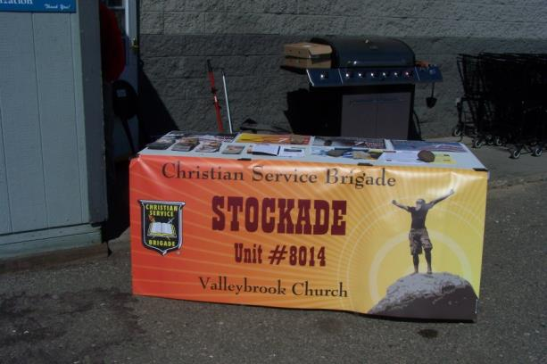
SERVICE
Events
OUTREACH

Slide 37
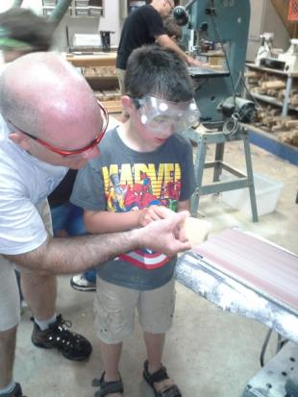
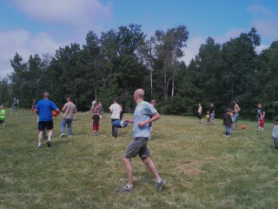
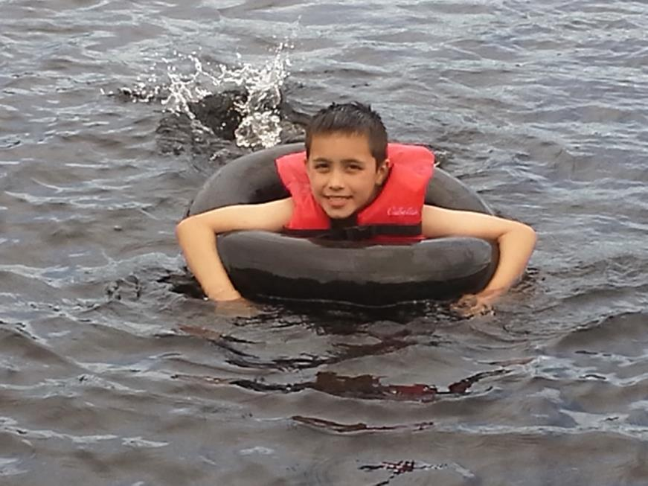
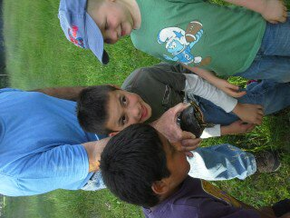
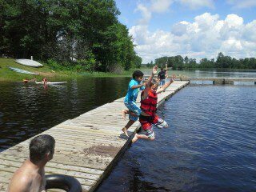
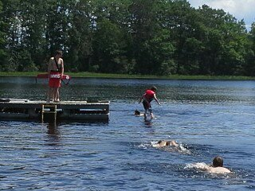
SUMMER
CAMP
Bonding

Slide 38
New Stockade Resources
Grow…
Your Boys
Your Men
Families
The Church

Slide 39
< End of Presentation >

Slide 40
Stockade 201 Using the Resources
Personal Achievement
Modules
Leader’s Guides
Trail Guides
Outpost Adventures

